Slide 1

Chicago Ikenobo Website Project

Slide 2
Team JBN
Project Lead: Jeremy Shankles
Project Developer: Brandon Phou
Project Documentation: Nicole Prebula

Slide 3
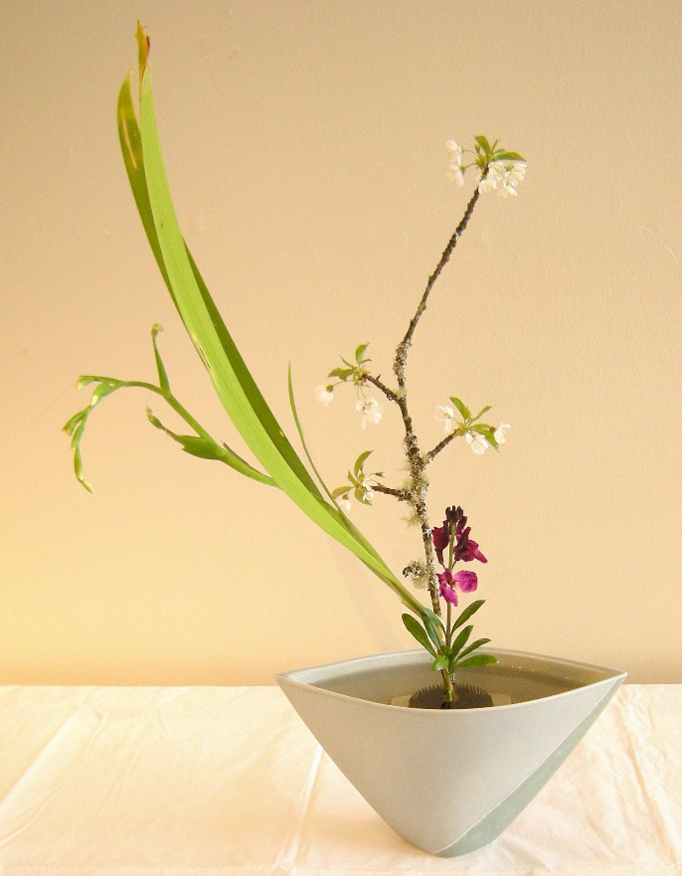
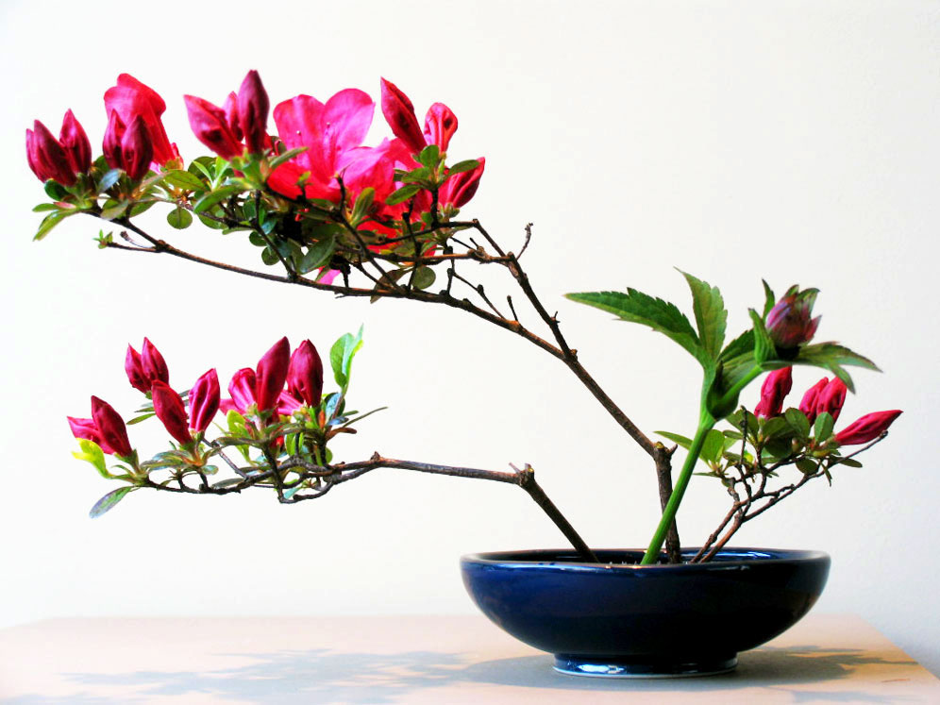
What is Ikenobo
Started over 550 years ago in Kyoto Japan
It is the school that started teaching Ikebana
Ikebana is the Japanese art of flower arrangement

Slide 4
Chicago Chapter of Ikenobo
4th oldest Chapter in North America
Founded in 1964 by Ikka Nakashima
Professor Charles Harris was appointed Nakashima’s successor

Slide 5
The Problem
Age
The members of the chapter are aging and no younger members are going
Membership
In the last 5 years, 2 members have joined the chapter
There current website: http://chicagoikenobo.org

Slide 6
The Project
Our Mission Statement:
Design, Document, Implement and Verify a new website for the Chicago Chapter of Ikenobo
This website must be creative and designed to attract younger members
The chapter is also looking at creating a Facebook, Twitter and Instagram accounts that will be linked to the website

Slide 7
The Plan
We will complete the project using a “modified” agile approach
Documentation
Meet with the client 2 times a month to go over progress
We will have team meetings at least once a week
We will use GitHub as part of our project management

Slide 8
Functional Requirements
Most important is viewable by mobile devices
Tabs:
About Us
Styles
50th Celebration
Contact Us
Other Ikenobo chapters and locations
Calendar of Events
Galleries

Slide 9
Nonfunctional Requirements
Most important is social media links
Ikenobo logo
“Cookies” that will enhance the website

